Slide 1
Administration Module

Slide 2
Features
Manage Terminal Keys
Manage User Roles
Manage Users
Manage Organizations
Province
City
Municipality
Barangay
Manage System Variables
Admin Tools
Export Remote Server Data
Import Remote Server Data

Slide 3
Roles
ADMIN.SYSADMIN

Slide 4
Manage Terminals
Generate Terminal Keys
Associate Terminal Key to specific client machine (Windows, Linux or Mac)
Location:
Home-> Administration-> Terminals

Slide 5
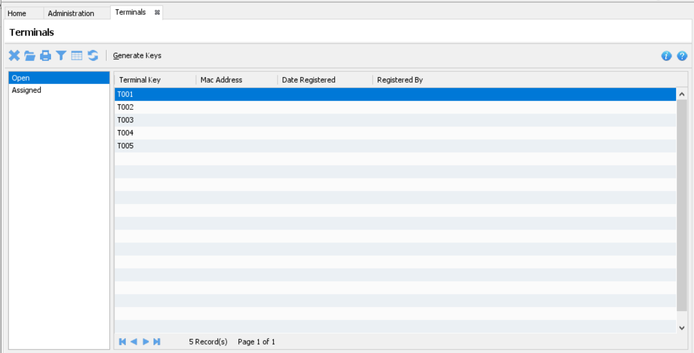
Manage Terminals

Slide 6
Manage User Roles
Create, Update and Delete User Role
Create, Update and Delete Permission
Belongs to a certain Domain or module
Majority of the roles are system defined
Location:
Home-> Administration-> Manage Roles

Slide 7
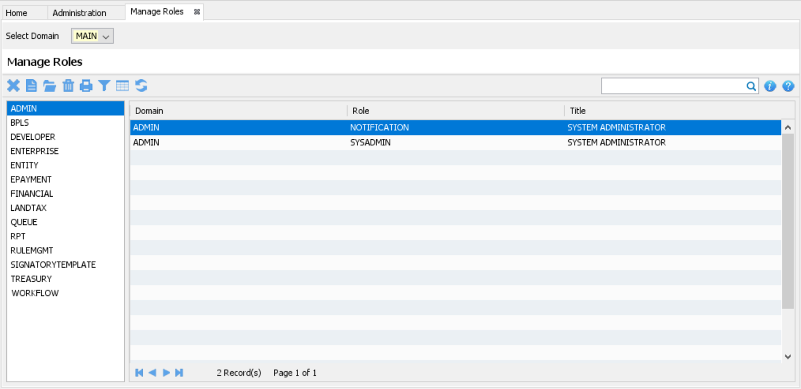
Manage User Roles

Slide 8
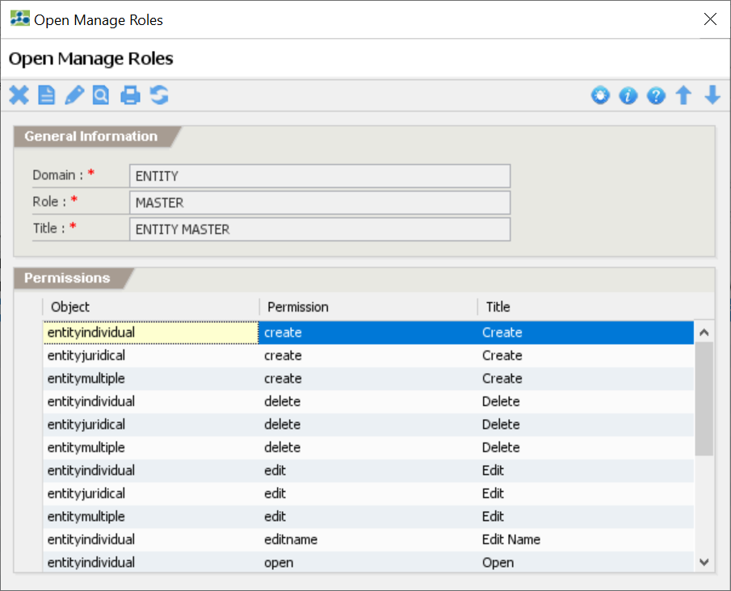
User Role

Slide 9
Manage Users
Create and Update User Account
Bind Roles and Permissions
Reset Password
Location:
Home-> Administration-> Manage Users

Slide 10
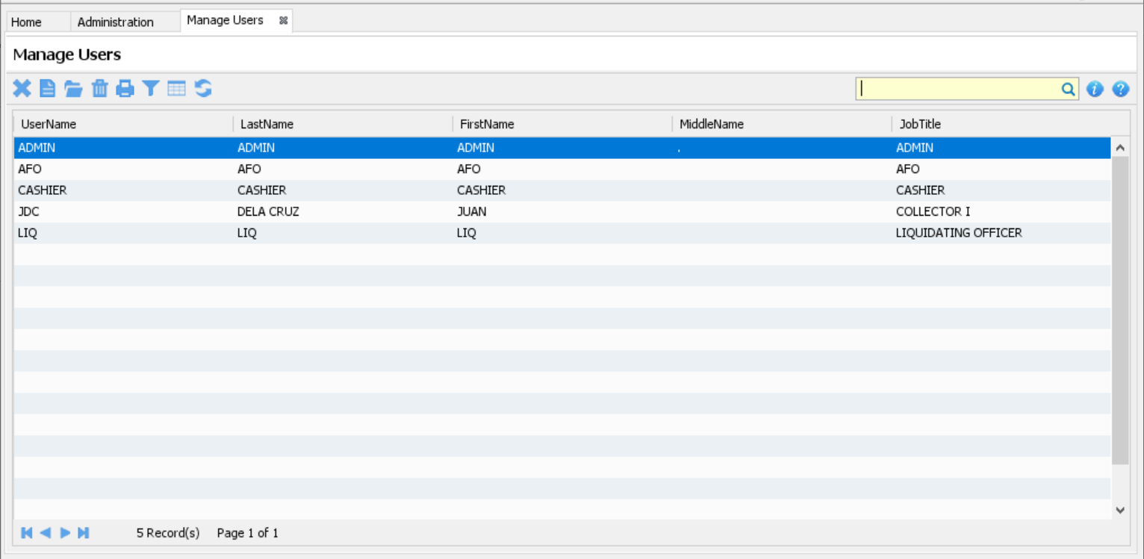
Manage Users

Slide 11
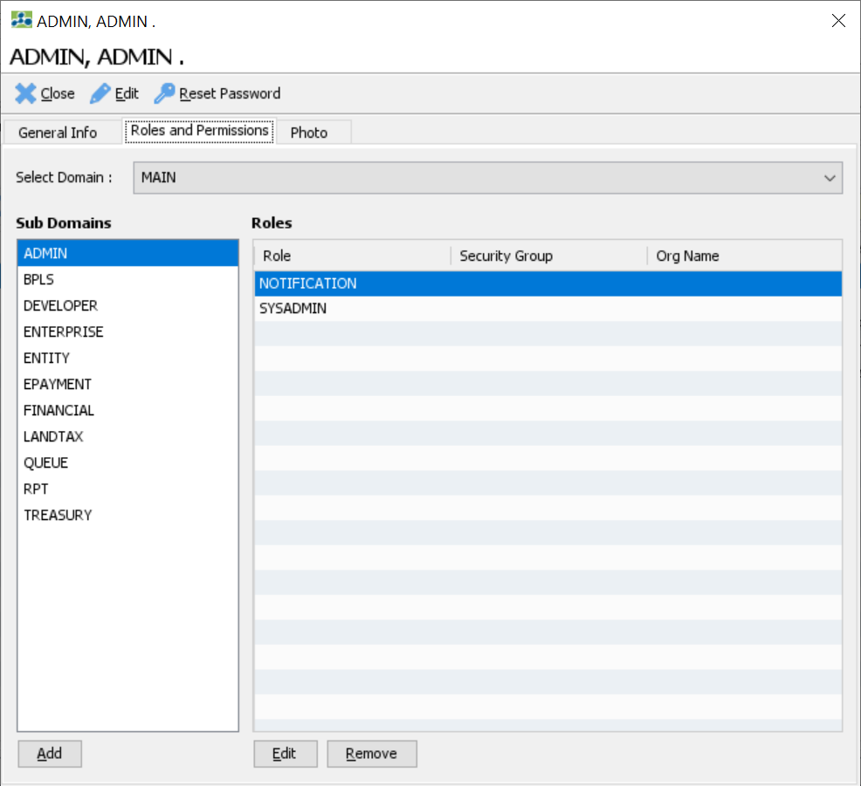
User

Slide 12
Manage Organizations
Create, Update and Delete Org Types
System Defined Org Types
Province
City
District
Municipality
Barangay
Location:
Home-> Administration-> Manage Organizations

Slide 13
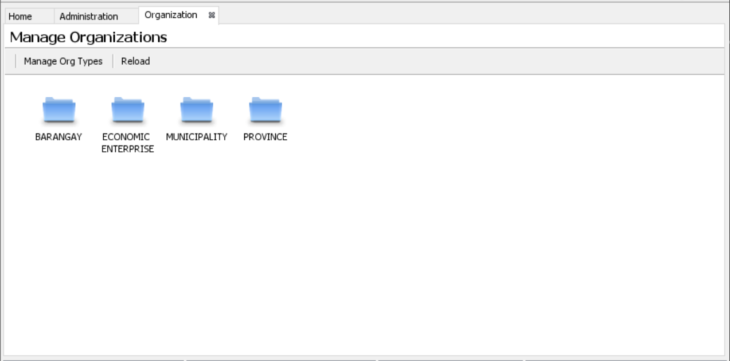
Manage Organizations

Slide 14
Activity-1: Update Municipality Info
Go to “Home-> Administration-> Organization-> Municipality”
Click the pencil icon to edit
Update the required fields that marked with (*)
Click the diskette icon to save the information

Slide 15
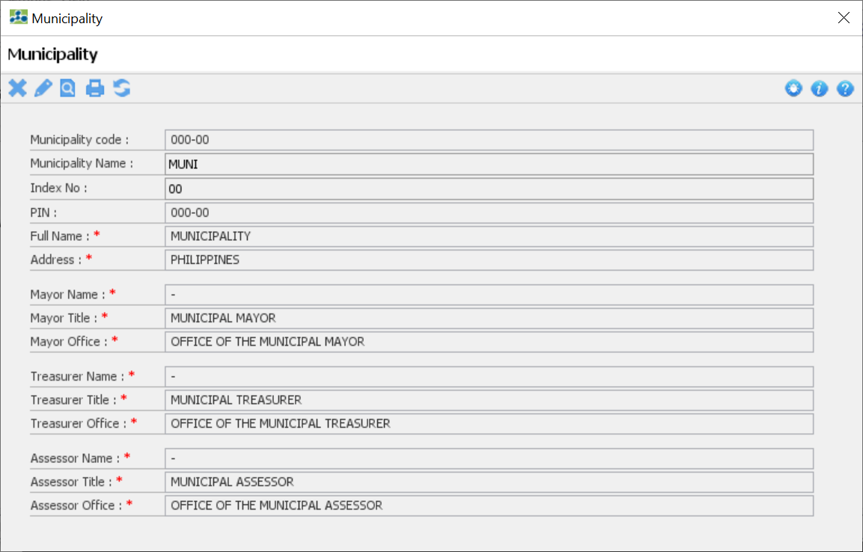
Municipality Info

Slide 16
Activity-2: Update Province Info
Go to “Home-> Administration-> Organization-> Province”
Click the pencil icon to edit
Update the required fields that marked with (*)
Click the diskette icon to save the information

Slide 17
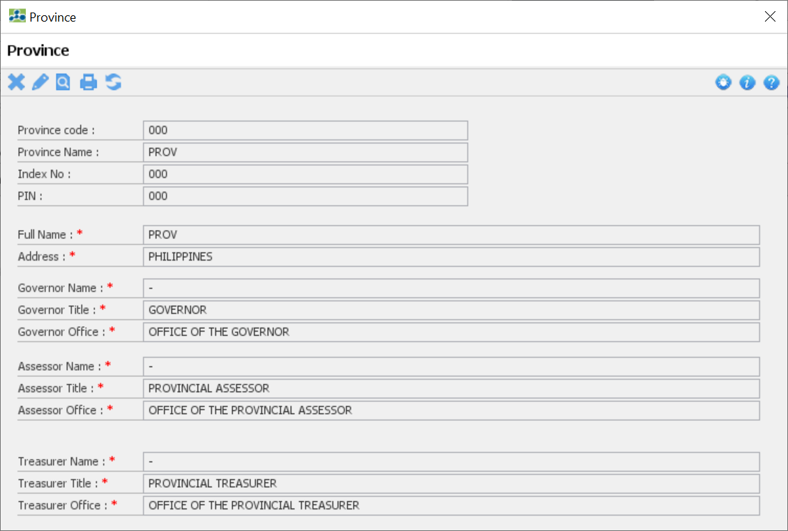
Province Info

Slide 18
Manage System Variables
Create, Update and Delete Variable
Majority of the variables are system defined
Location:
Main Menu-> Settings-> System Variables

Slide 19
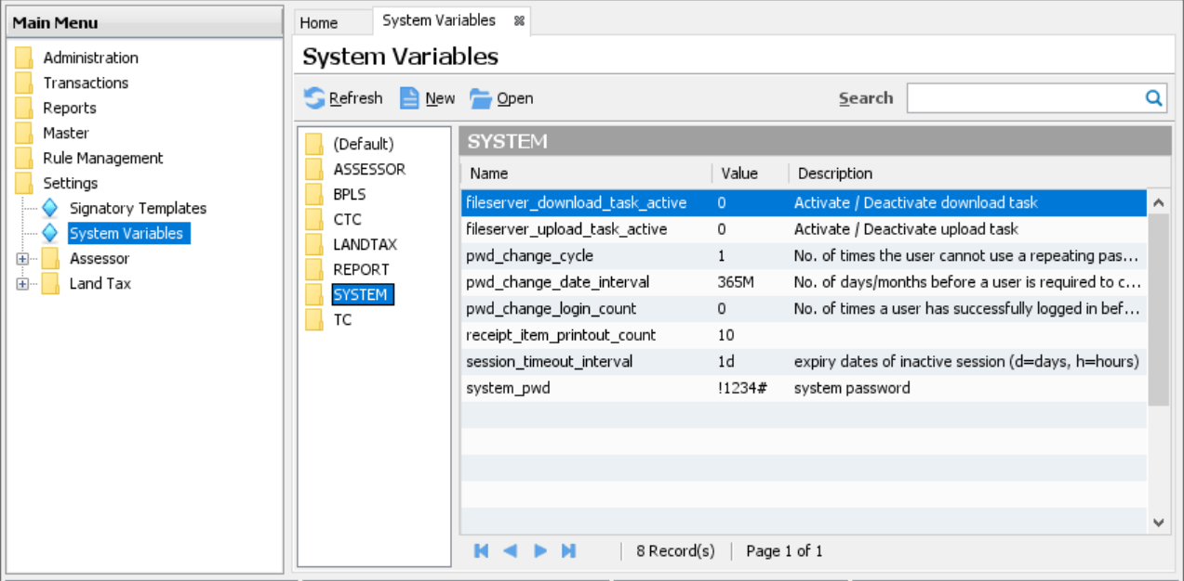
Manage System Variables

Slide 20
Admin Tools
Export Data from a Host Server
Import Data to a Remote Server
Location:
Main Menu-> Transactions-> Admin Tools

Slide 21
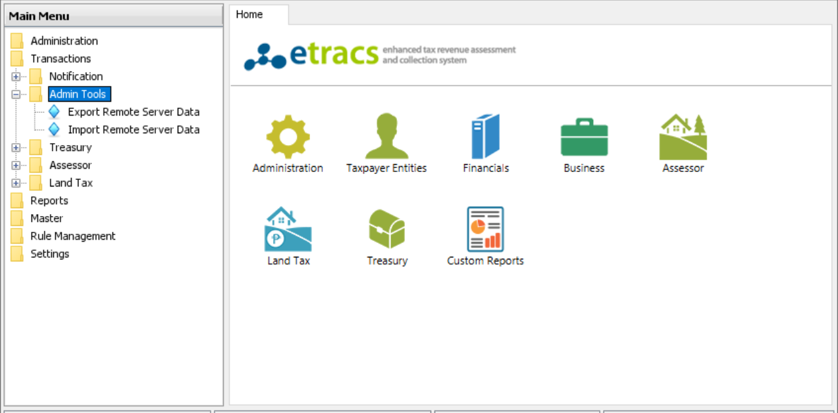
Admin Tools

Slide 22
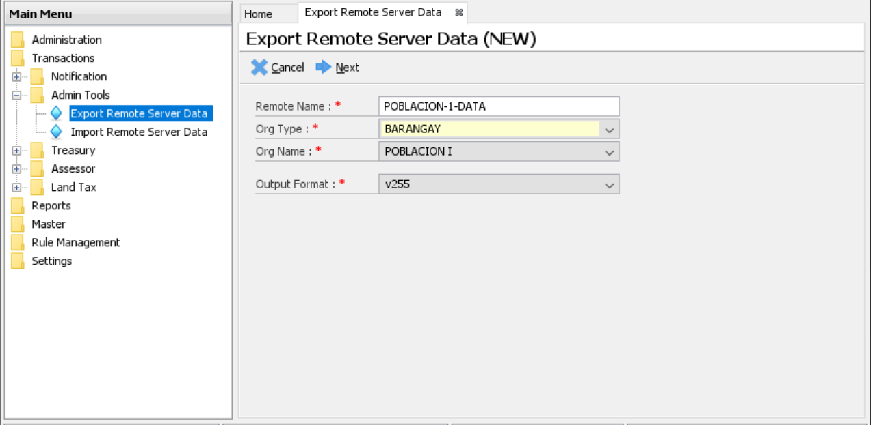
Export Data Screen

Slide 23
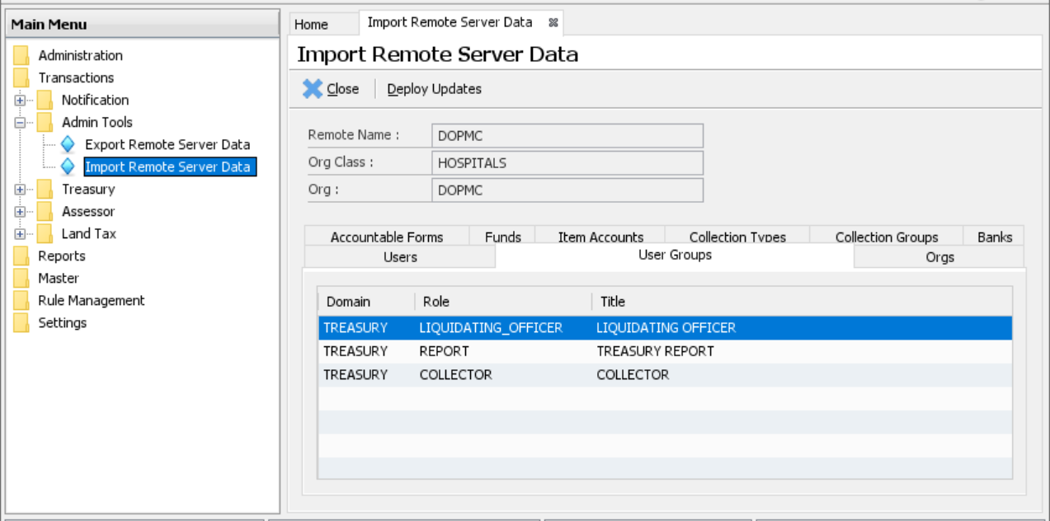
Import Data Screen

Slide 24
Up Next Taxpayer Profiling (Entity)

